Slide 1
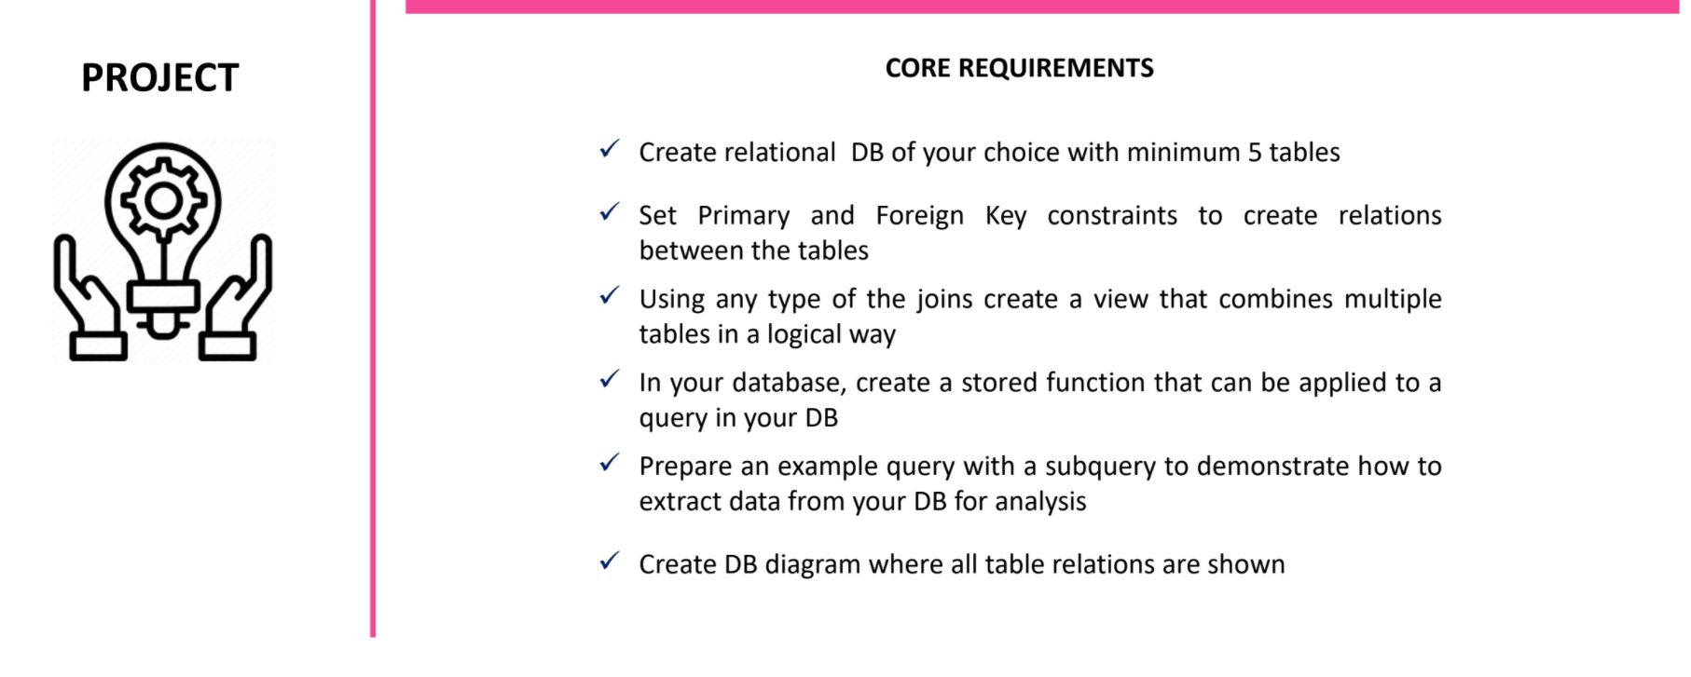

Slide 2
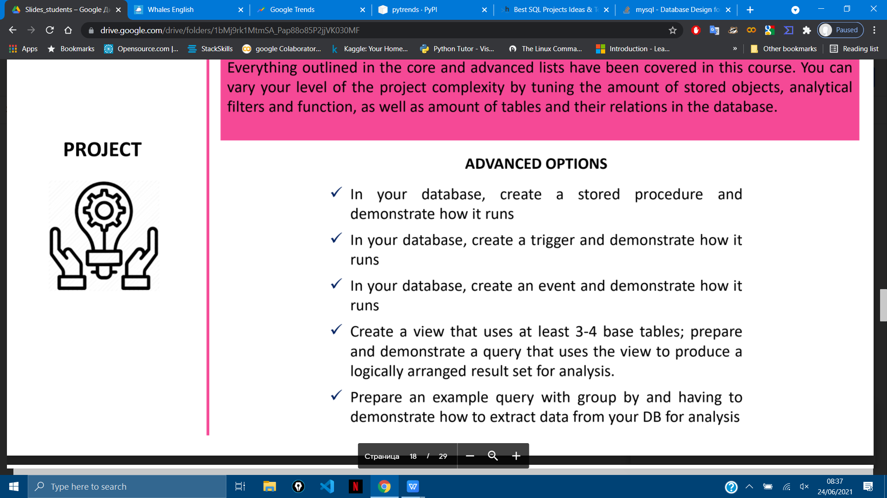

Slide 3


Slide 4
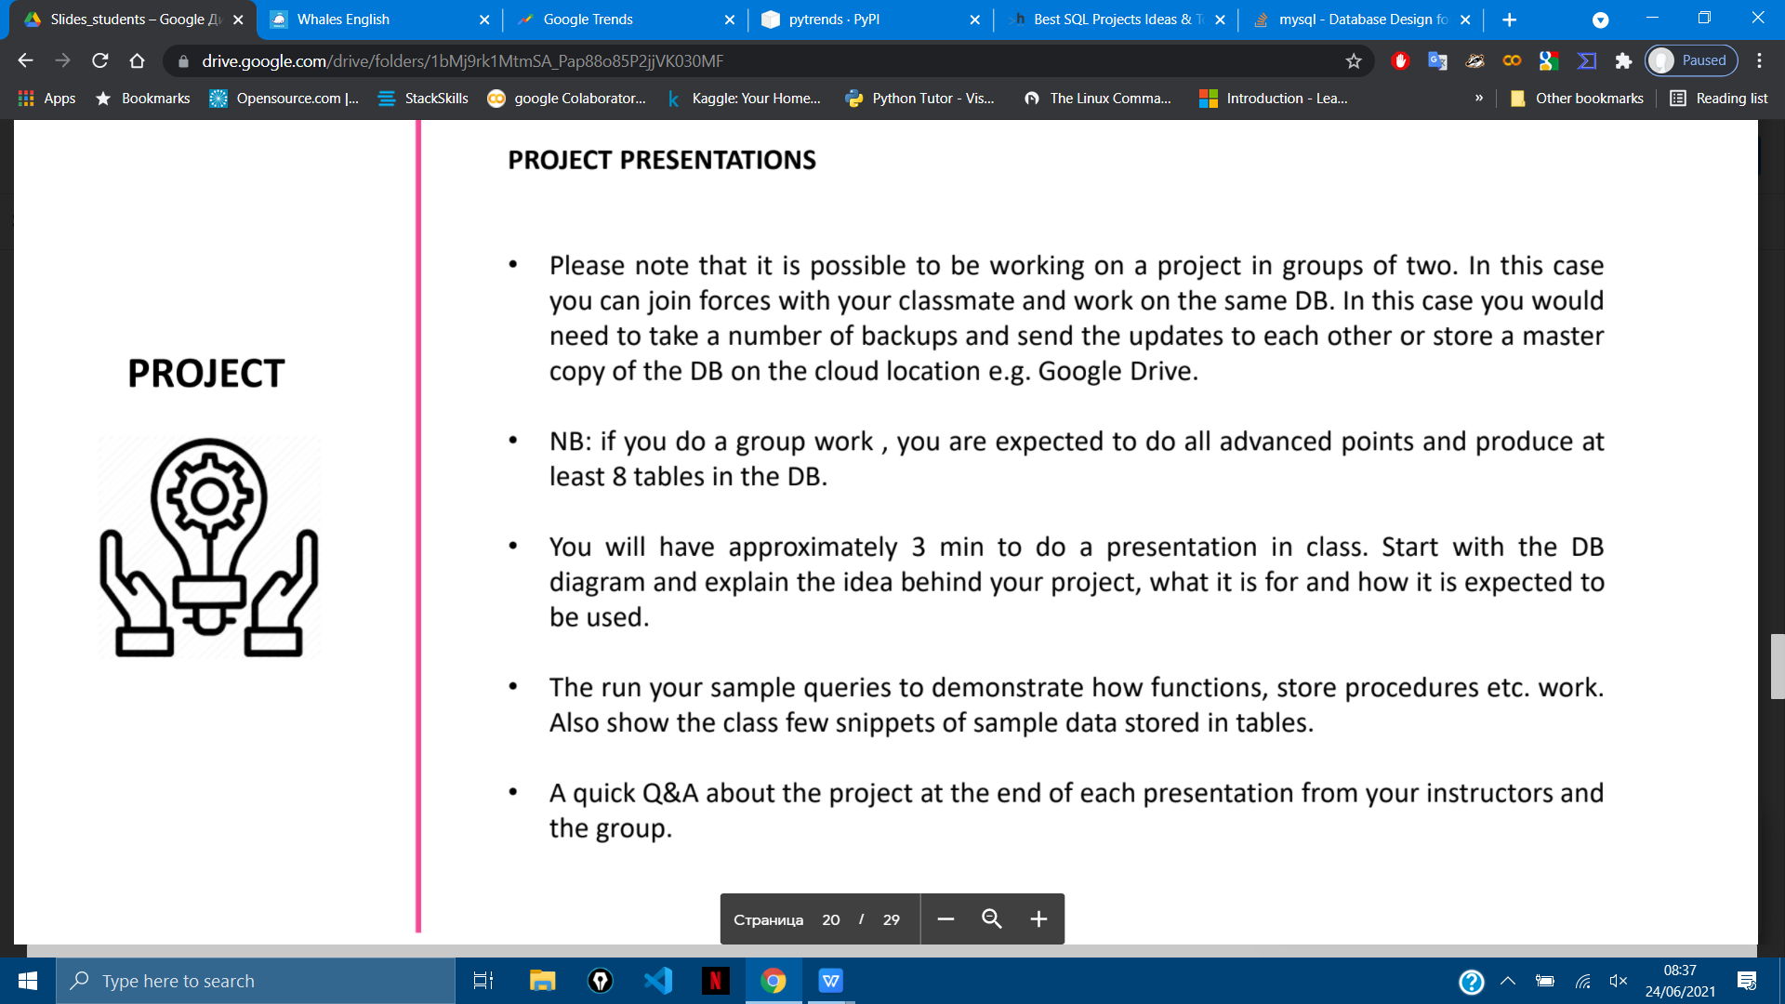

Slide 5
http://www.adrianmassey.com/web1/index.php
Races-table(primary key RaceId): RaceId(int), RaceCourse(Varchar), RaceDate(date), RaceTime(varchar), RaceName(Varchar), RaceNumber(int), RaceConditions(varchar), RaceType(Varchar),RaceClass(int), RaceGoing(varchar), RaceDirection(varchar),RaceDistance(int), RaceFences(number of fences)(int), RaceRunners(number of runners)(int), RaceFinishers(number of finishers)(int), RacePrice(int), WinningTimeInSeconds(decimal) Horses-table(primary key horseId, RaceId) HorseId(int), RaceId(int), HorseName(varchar), HorseDOB(date), HorseForm(varchar), HorseGender(varchar), HorseAge(int), HorseOrigin(country)(Varchar), HorseStallNumber(int), HorseRating(official rating)(int), CreatedRating(own or for example Racing Post's rating)(int),HorseRatingDifference(compared to best rating + or -)(int) HorseHandicapWeight(int),HorseMorningPrice(decimal), HorseStartingPrice(decimal),HorsePriceBetfair(decimal), HorsePlacePrice(decimal), HorsePlacePriceBF(decimal), HorseTrainer(varchar),HorseJockey(varchar), HorseOwner(varchar), HorsePosition(finishing position)(int), HorseWonBy(lenghts)(decimal), HorseLostBy(lenghts)(decimal),HorseFinishingTimeSeconds(decimal), HorseLastRacedInDays(int), NumberOfRacesIn30Days(int), NumberOfRacesin60Days(int) That's what I thought of for starters.

Slide 6
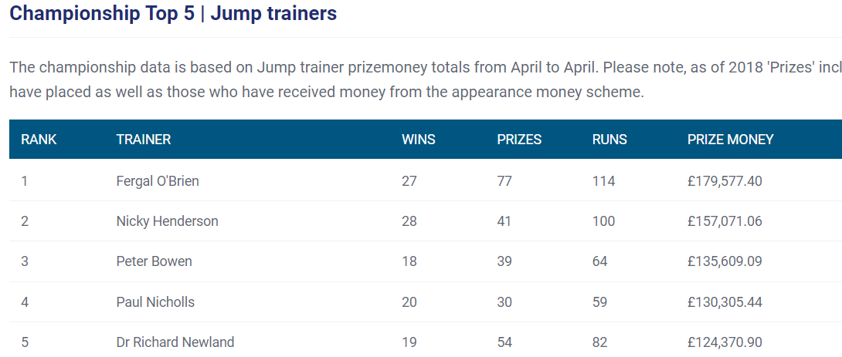
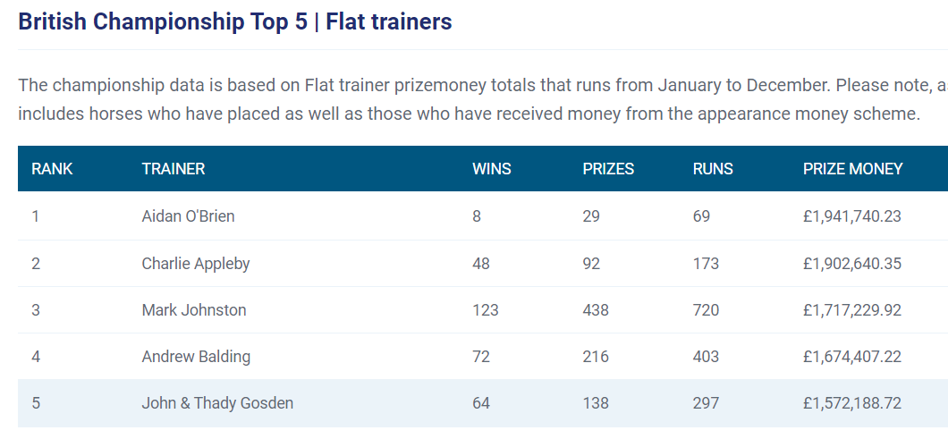
Yard/ Trainers
yardID
regNUM
yard_name (10 entries)
http://adrianmassey.no-ip.org/web1/pages/ractra.php

Slide 7
Horse (50)
regNum
name
gender
type
DOB
PRICE
datebought
https://www.timeform.com/horse-racing/features/top-horses/timeforms_top_european_flat_horses
https://www.equibase.com/stats/ViewAllTime.cfm?tf=all-time&tb=horse&vb=E

Slide 8
RACE (60)
https://www.britishhorseracing.com/racing/racecourses/
https://www.racingformbook.com/basic-racing-results-csv-format/
fixtures
https://www.racingpost.com/guide-to-racing/horse-racing-fixture-list-2020/

Slide 9
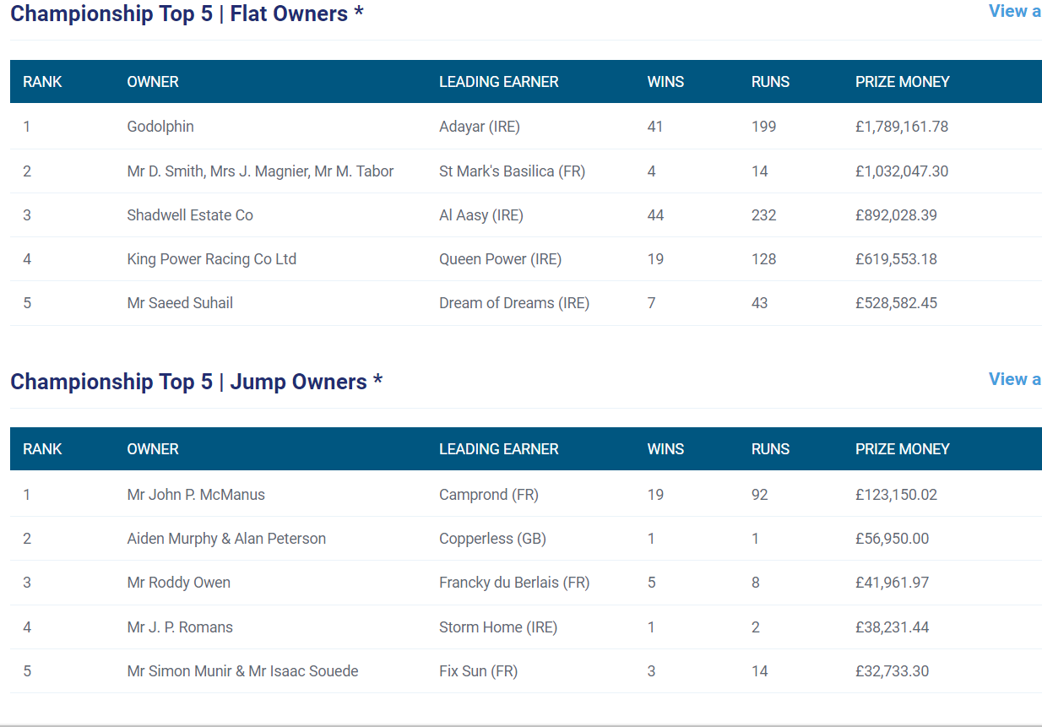
Owner -
https://www.britishhorseracing.com/racing/participants/owners/

